Slide 1
UrbanNest Growth Strategy
A 3-Year Strategic Expansion Roadmap
Prepared by Lakshya Maheshwari
Current Business Snapshot
12
₹28 Cr
Current Stores
Current Revenue
Physical retail footprint across Pune
Annualised FY24 revenue
30
₹80 Cr
Target Stores
Target Revenue
Expansion target by Year 3
Ambitious but achievable goal
Current Business Position
Key Strategic Challenge
Mid-sized home furnishing retail chain based in Pune
Operates 12 physical stores across the region
Growing in India's expanding home furnishing market
Small market share with significant growth potential
How can UrbanNest grow from ₹28 crore to ₹80 crore whilst expanding from 12 to 30 stores — without compromising operational efficiency, profitability, or customer experience?

Slide 2

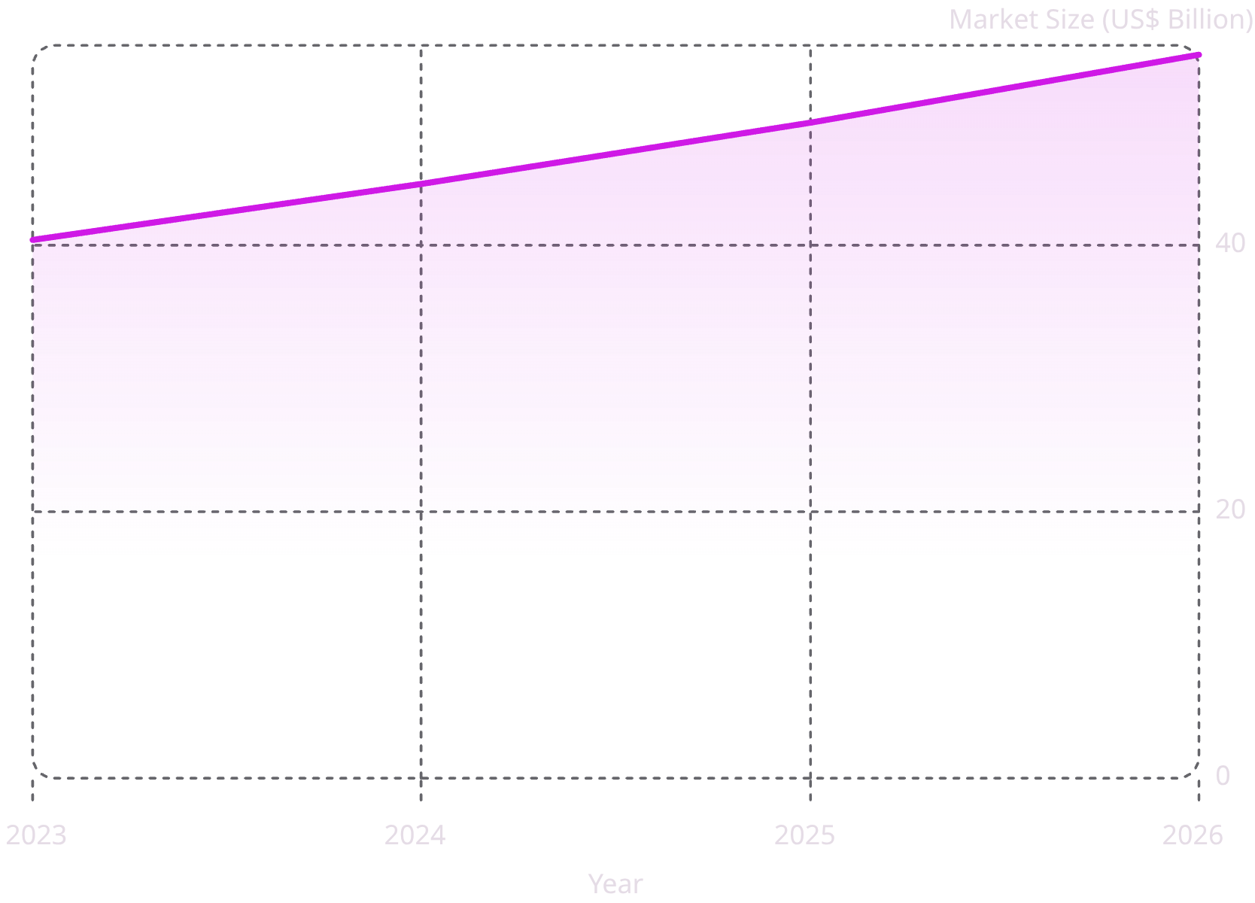





Indian Home Furnishing Market Opportunity
The Indian home furnishing market is on a sustained growth trajectory, projected to reach US$54.3 billion by 2026. This expansion is fuelled by structural shifts in consumer behaviour and macroeconomic tailwinds.
Omnichannel Retail
Customers expect seamless online and offline shopping experiences.
Modular Furniture
Growing demand among urban households seeking flexibility.
Sustainability
Increasing preference for eco-friendly, responsibly sourced products.
Experience-led Retail
Customers prefer experiencing furniture before purchasing.
Tier-2 City Expansion
Emerging cities offer strong long-term growth opportunities.
India's home furnishing market is expanding steadily, creating strong opportunities for organised retailers with scalable and customer-focused business models.

Slide 3

Recommended Growth Strategy
Phased Omnichannel Expansion
UrbanNest should strengthen operations first, build a seamless omnichannel presence, and then expand selectively into high-potential markets to achieve sustainable long-term growth.
Each phase builds upon the previous, ensuring UrbanNest expands from a position of operational strength rather than premature scaling.
Three pillars of the strategy
Operational Strengthening
Omnichannel Integration
Selective Geographic Expansion
Focus on building a more resilient foundation through supply chain improvements, tighter inventory management, and standardized processes across the business.
Create a seamless online-offline customer experience by aligning digital touchpoints, physical stores, and customer data into one connected journey.
Expand cautiously into high-potential tier-2 cities where demand is attractive and execution can be scaled efficiently, including markets like Ahmedabad and Indore.
Improve supply chain reliability
Strengthen inventory visibility and control
Standardize core operating processes
Unify the customer experience across channels
Strengthen digital presence and discovery
Use customer data to improve personalization
Prioritize high-potential tier-2 cities
Target markets such as Ahmedabad and Indore
Expand only where operational readiness is strong

Slide 4

Three-Year Growth Roadmap
01
02
03
Year 1 · Foundation
Year 2 · Measured Expansion
Year 3 · Scale & Sustain
Strengthen inventory management and supply chain. Launch omnichannel improvements. Standardise store operations across all locations.
Open stores in Ahmedabad and Indore. Monitor store performance closely. Improve customer acquisition through targeted marketing.
Expand into additional high-potential cities. Scale the proven operating model. Achieve 30 stores and ₹80 crore annual revenue.
Key Success Factors
Operational Excellence
Customer Experience
Data-Driven Decisions
Disciplined Expansion
Standardised, replicable store model
Seamless omnichannel journey
Performance tracking at every step
Validate before scaling further

Slide 5

Key Risks & Mitigation Plan
Risk
Impact
Mitigation
Rapid Expansion
Risk 1
Higher operating costs
Inventory challenges
Poor customer experience
Phase expansion carefully
Strengthen supply chain
Standardise operations
Strong Competition
Risk 2
Lower market share
Pricing pressure
Slower customer acquisition
Differentiate through service
Localised product offerings
Strong omnichannel strategy
Poor Market Selection
Risk 3
Low store profitability
Slow revenue growth
Evaluate customer demand
Study income levels & competition
Assess real estate growth
Disciplined execution and operational readiness are more important than rapid expansion.

Slide 6

Strategic Recommendations
Operations First
Omnichannel Growth
Strengthen supply chain, inventory management, and store operations before any expansion begins.
Build an integrated online and offline customer experience that drives convenience and loyalty.
Smart Expansion
Long-Term Success
Expand gradually, beginning with Ahmedabad and Indore before entering additional markets.
Use data-driven decisions to improve profitability and support sustainable, scalable growth.
Final Recommendation
Why Konsyte
UrbanNest should adopt a phased omnichannel expansion strategy — first strengthening internal operations, then building integrated online and offline capabilities, and finally expanding selectively into high-potential cities such as Ahmedabad and Indore. This balanced approach will help the company achieve 30 stores and ₹80 crore annual revenue whilst maintaining operational efficiency, profitability, and customer satisfaction.
As a strategic partner, Konsyte brings deep expertise in retail expansion, omnichannel transformation, and operational excellence. We work alongside leadership teams to turn growth ambitions into measurable results.
Prepared by - Lakshya Maheshwari

